Slide 1

IMDB Movie Analysis
A Data Analysis Project
Name: Prince Kumar Email: prince22495@gmail.com

Slide 2
Content
Project Description
Approach
Tech-Stack Used
Analysis and Insights
Conclusion

Slide 3
Project Description:
Project Title: IMDB Movie Analysis
Problem Statement:
The IMDB movie dataset is a large and complex dataset. It contains a variety of information about movies, including the director, title, year, actor, language, number of votes, IMDb score and various other columns. This dataset can be used to answer a variety of questions about movies, such as:
Which movies have the highest profit?
What are the top 250 movies?
What are the top movies in foreign language?
Who are the best directors?
What are the most popular genres?

Slide 4
Approach
The project will be divided into three phases:
1. Data cleaning
The first phase of the project will involve cleaning the dataset. This will include removing errors and missing values, and formatting the data so that it is consistent.
Tools: Excel formulas, SQL queries
Tasks: Identify and remove errors, identify and fill in missing values, format data
2. Data analysis
The second phase of the project will involve analyzing the dataset. This will include answering questions about movies, such as which movies have the highest profit, what are the top 250 movies, and who are the best directors.
Tools: Excel formulas, SQL queries, data visualization tools
Tasks: Ask and answer questions about movies, create visualizations of the data
3. Data visualization
The third phase of the project will involve creating visualizations of the data. This will help to communicate the results of the analysis and make it easier to understand.
Tools: MS Excel for charts.
Tasks: Create visualizations of the data, communicate the results of the analysis

Slide 5


Tech-Stack Used
MS Excel
MYSQL

Slide 6
Analysis & Insights

Slide 7
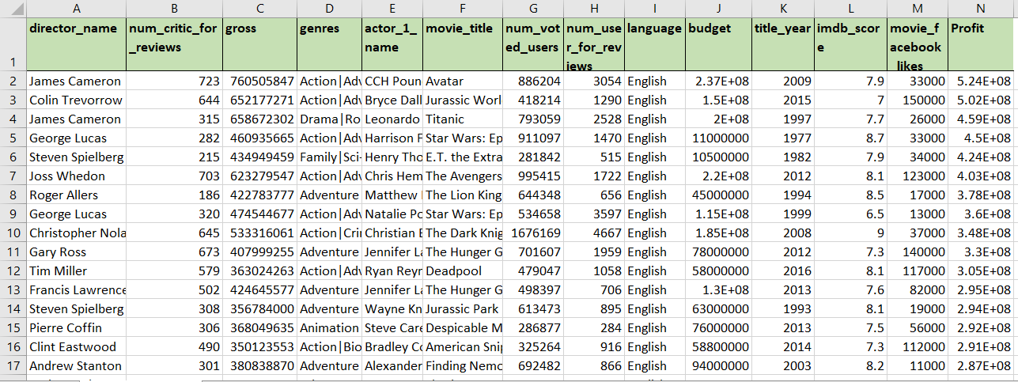
A. Cleaning the data
I cleaned the dataset using the following steps:
I used the filter function in Excel to filter out all the blank cells in each column.
I deleted all the blank cells from each column.
I deleted a few columns that were not required for my analysis.
I removed duplicates from the dataset.
After completing these steps, I was left with 14 columns and 3724 rows. The dataset was now clean and ready to be imported into MySQL for further analysis.

Slide 8
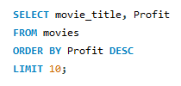
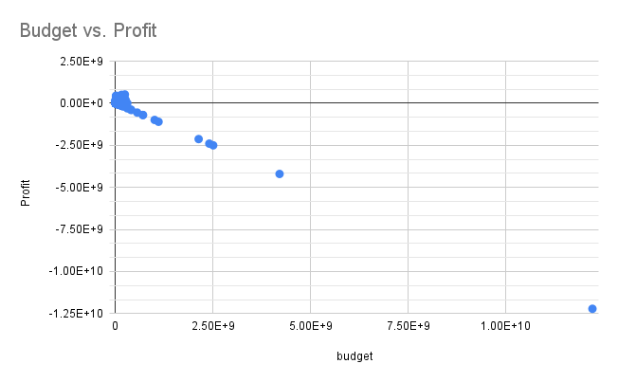
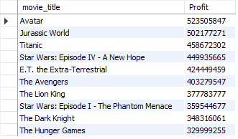
B. Movies with highest profit
Task: Find the movies with the highest profit?
Movie Avatar has made the highest profit.
In this scatter plot, we can see an outlier at around
-1.25E+10 point.

Slide 9
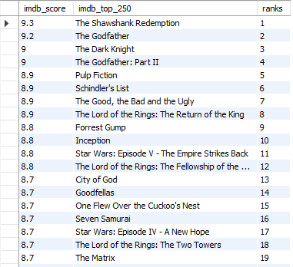
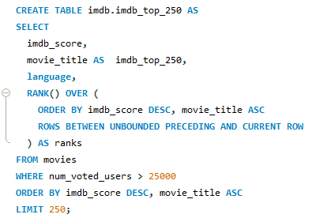
C. What are the top 250 IMDB movies?
Task: Find IMDB Top 250 Create a new column IMDb_Top_250 and store the top 250 movies with the highest IMDb Rating (corresponding to the column: imdb_score). Also make sure that for all of these movies, the num_voted_users is greater than 25,000. Also add a Rank column containing the values 1 to 250 indicating the ranks of the corresponding films.
First movie is “The Shawshank Redemption” with a 9.3 IMDB score, among the top 250 IMDB movies list.

Slide 10
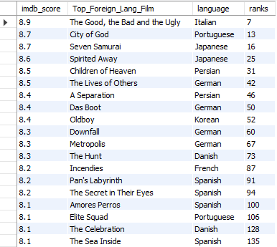

Top IMDB Foreign Language Movies:
Task: Extract all the movies in the IMDb_Top_250 column which are not in the English language and store them in a new column named Top_Foreign_Lang_Film. You can use your own imagination also!
Top foreign Language Movie came out to be “The Good, the Bad and the Ugly”.

Slide 11
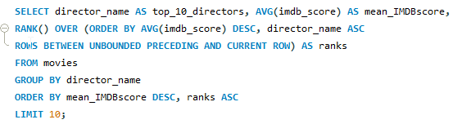
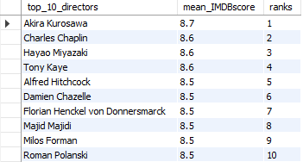
D. Who are the best directors?
Find out the top 10 directors for whom the mean of imdb_score is the highest and store them in a new column top10director. In case of a tie in IMDb score between two directors, sort them alphabetically. Task: Find the best directors
The best director is Akira Kurosawa with the mean IMDB score of 8.7.

Slide 12
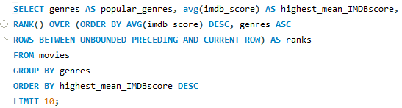
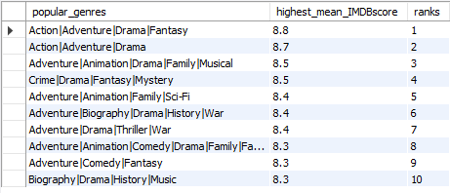
E. What are the most popular genres?
Perform this step using the knowledge gained while performing previous steps. Task: Find popular genres
Action|Adventure|Drama|Fantasy came out to be the most popular genre with the highest mean IMDB score of 8.8.

Slide 13
F. Charts
Task: Find the critic-favorite and audience-favorite actors
Create three new columns namely, Meryl_Streep, Leo_Caprio, and Brad_Pitt which contain the movies in which the actors: 'Meryl Streep', 'Leonardo DiCaprio', and 'Brad Pitt' are the lead actors. Use only the actor_1_name column for extraction. Also, make sure that you use the names 'Meryl Streep', 'Leonardo DiCaprio', and 'Brad Pitt' for the said extraction. Append the rows of all these columns and store them in a new column named Combined. Group the combined column using the actor_1_name column. Find the mean of the num_critic_for_reviews and num_users_for_review and identify the actors which have the highest mean. Observe the change in number of voted users over decades using a bar chart. Create a column called decade which represents the decade to which every movie belongs to. For example, the title_year year 1923, 1925 should be stored as 1920s. Sort the column based on the column decade, group it by decade and find the sum of users voted in each decade. Store this in a new data frame called df_by_decade.

Slide 14
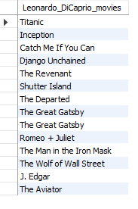

Leonardo DiCaprio Movies List

Slide 15
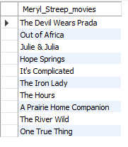

Meryl Streep Movies List

Slide 16
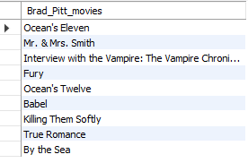

Brad Pitt Movies List

Slide 17
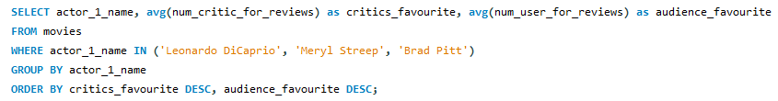

Critic-favourite and audience-favourite actors
Leonardo DiCaprio is the critics favourite as well as audience favourite actor, having the most number of reviews in from both critics and audience.

Slide 18
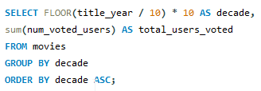
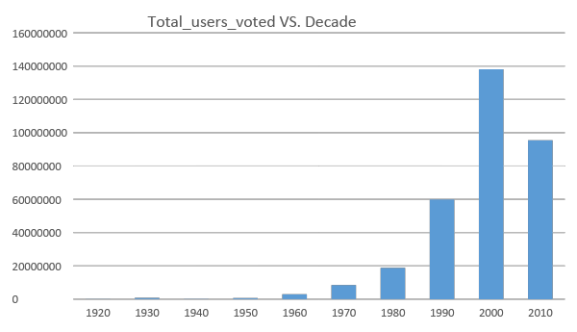
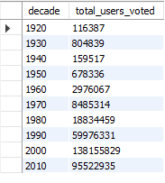
Change in number of voted users over decades
Number of voted users are the most in 2000s.

Slide 19
Conclusion
After cleaning the dataset, I was left with 14 columns and 3724 rows. The dataset was now clean and ready to be imported into MySQL for further analysis.
Movie Avatar has made the highest profit.
First movie is “The Shawshank Redemption” with a 9.3 IMDB score, among the top 250 IMDB movies list.
Top foreign Language Movie came out to be “The Good, the Bad and the Ugly”.
The best director is Akira Kurosawa with the mean IMDB score of 8.7.
Action|Adventure|Drama|Fantasy came out to be the most popular genre with the highest mean IMDB score of 8.8.
Leonardo DiCaprio is the critics favourite as well as audience favourite actor, having the most number of reviews in from both critics and audience.
Number of voted users are the most in 2000s.

Slide 20
File Links
Project Link: Click Here!
Working File Link: csv file SQL file

Slide 21
Thank You! ^_^

